Slide 1
Ills of Illiteracy In Pakistan
Presented By:
Muhammad Ahmad Mahad Sheikh
Farheen Akmal
Nimra Amir

Slide 2
Outline
Introduction
Causes of illiteracy
Consequences
Possible solutions
Conclusion

Slide 3
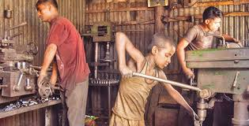
Introduction
Hook:
“Families living in poverty often rely on their children to contribute to the household’s income. Unfortunately, this responsibility can block their ability to attend school”
Illiteracy:
“Ill literacy is a state whereby one is unable to read or write”

Slide 4
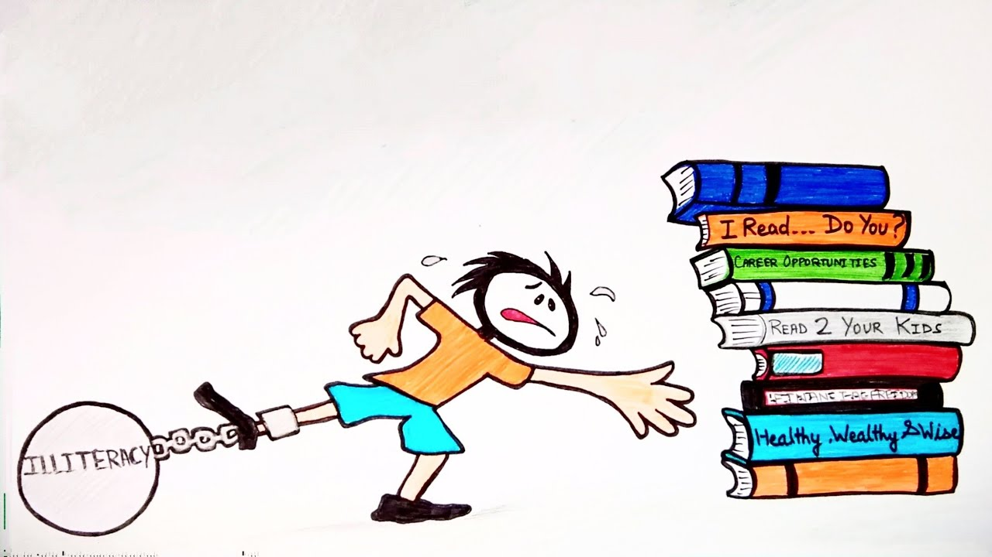
Causes of Illiteracy
Illiteracy among parents
Lack of family support
Unemployment of the educated
Lack of awareness

Slide 5
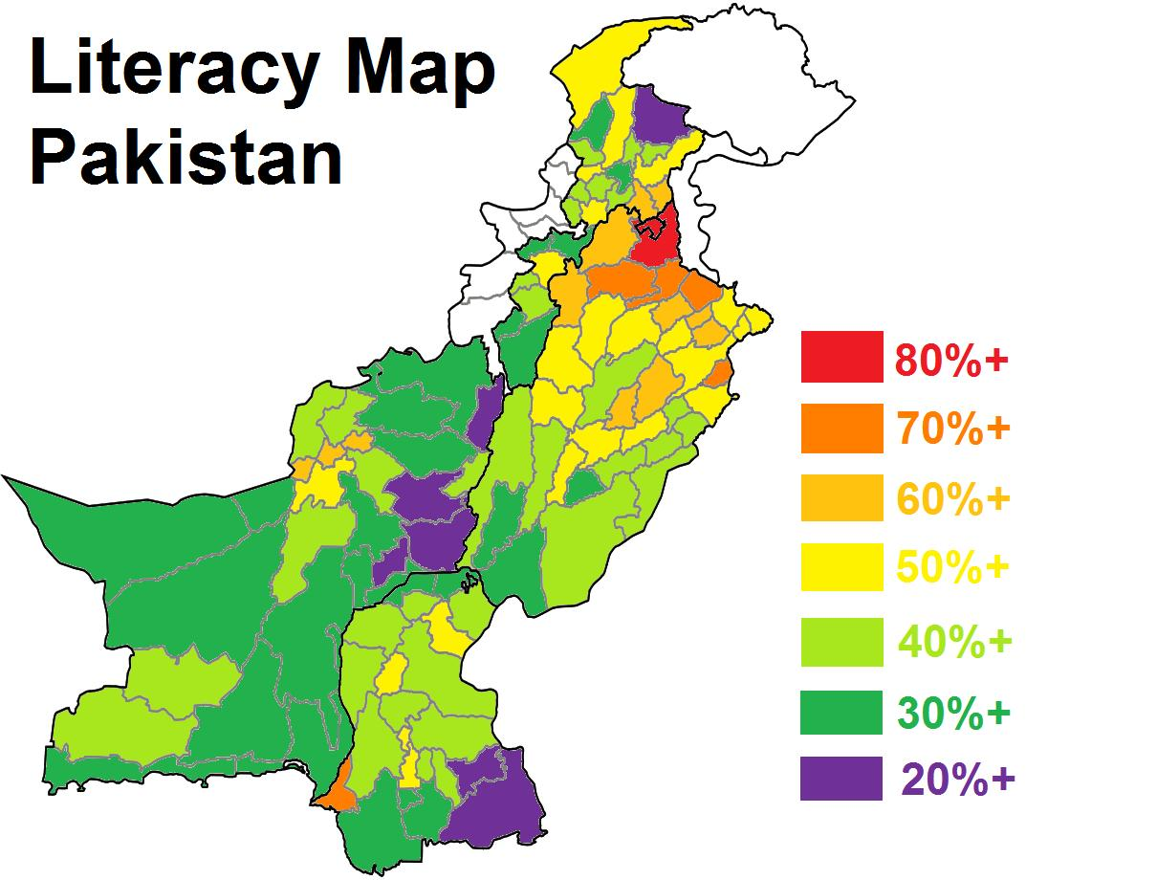

Slide 6
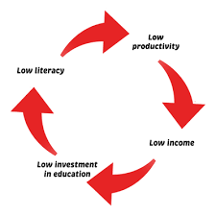
Causes of Illiteracy
Social barrier
Lack of facilities
Poverty

Slide 7
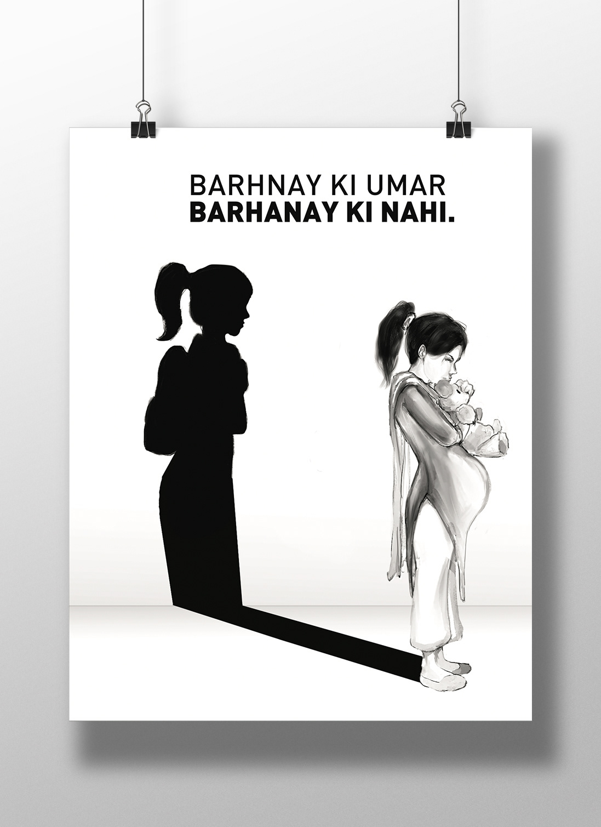
Consequences
Hinders economic social progress
Poverty
Child marriage

Slide 8
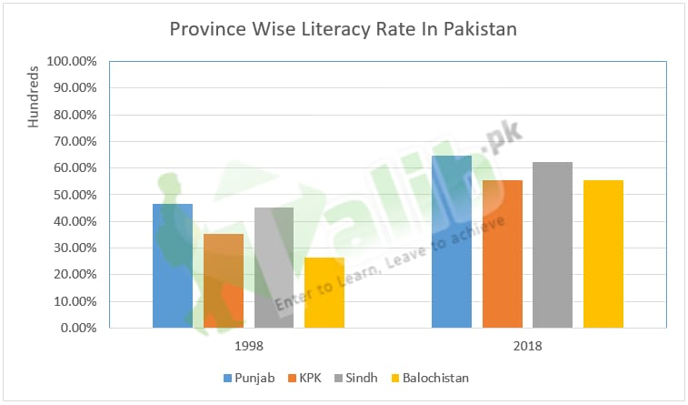

Slide 9
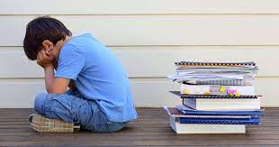
Consequences
Difficult life
Social crimes
Underpayment
Intergenerational illiteracy

Slide 10

Solutions
Free education
Awareness

Slide 11
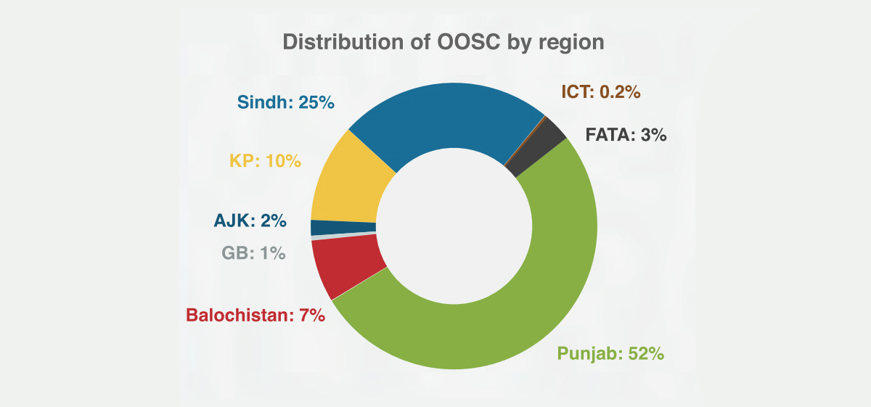

Slide 12

Solutions
Grants
Late night classes
Free books digitalization
Lower educational cost

Slide 13
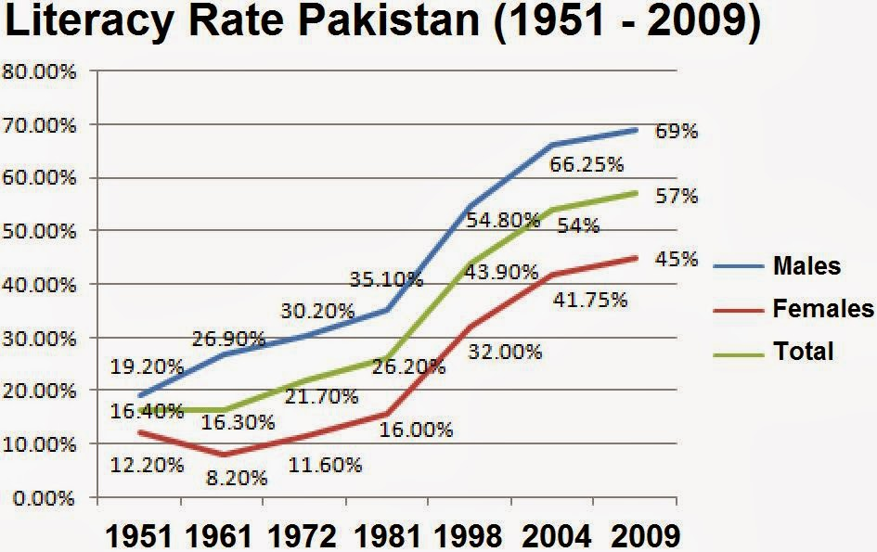

Slide 14
2.Intelligence necessary to overcome everyday life challenges
conclusion
1.The value of education can not be underestimated.
4.Everyone should aspire to be educated and gain knowledge
3.Illlitracy has no room in the modern society

Slide 15
Thanks!
Do you have any questions?

